Slide 1

Test Flutter apps on an Android device
3 Steps are needed:
Turn on Developer Options menu on the device
Enable USB Debugging on the device
Allow USB Debugging when your device is connected
BTW: The following screenshots with English in Android were taken from https://www.samsung.com/uk/support/mobile-devices/how-do-i-turn-on-the-developer-options-menu-on-my-samsung-galaxy-device/

Slide 2
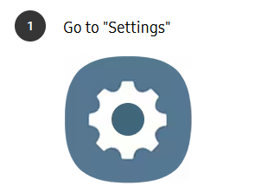
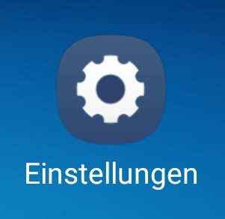
Turn on Developer Options

Slide 3
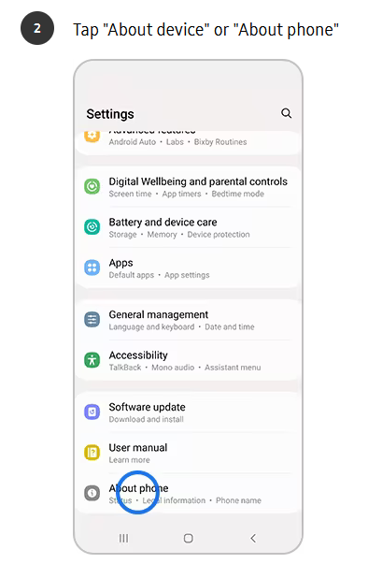
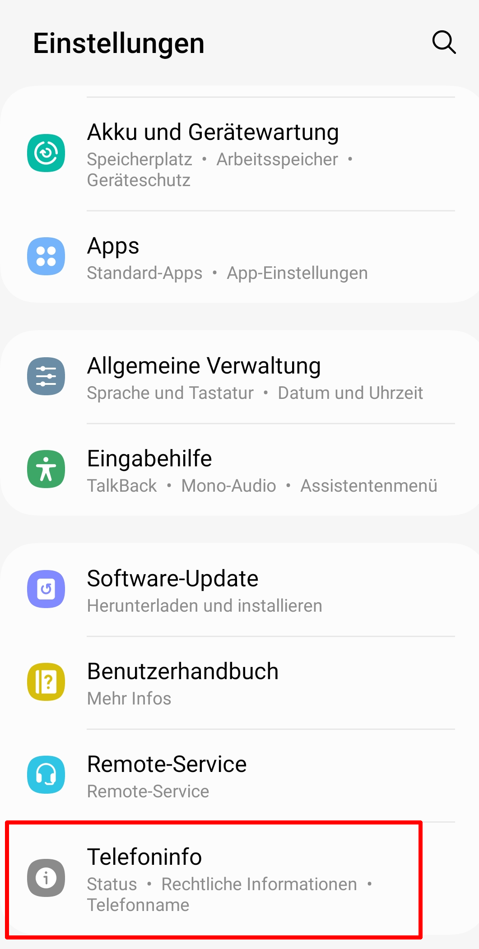

Slide 4
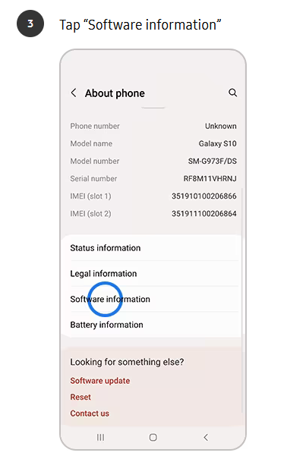
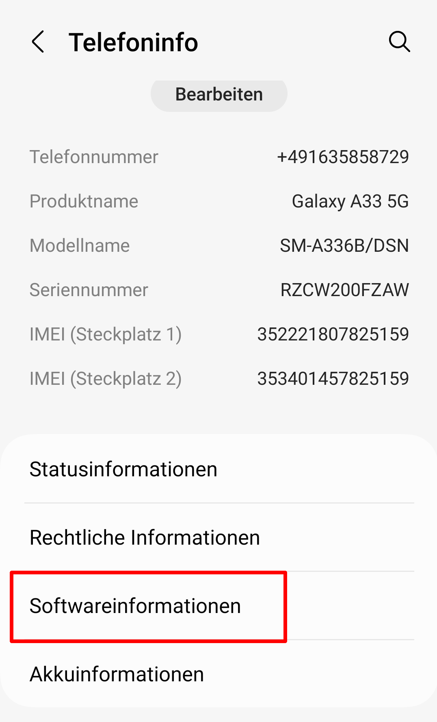

Depending on your operating system, you may not need to follow this step

Slide 5

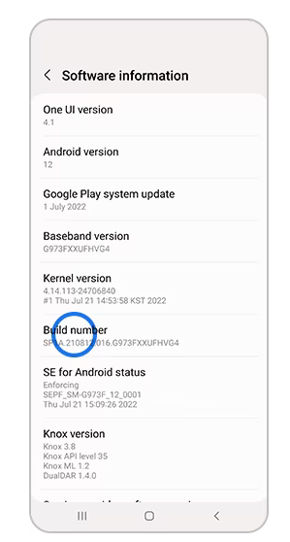
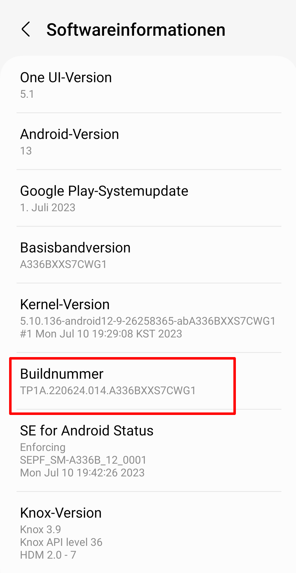


Slide 6
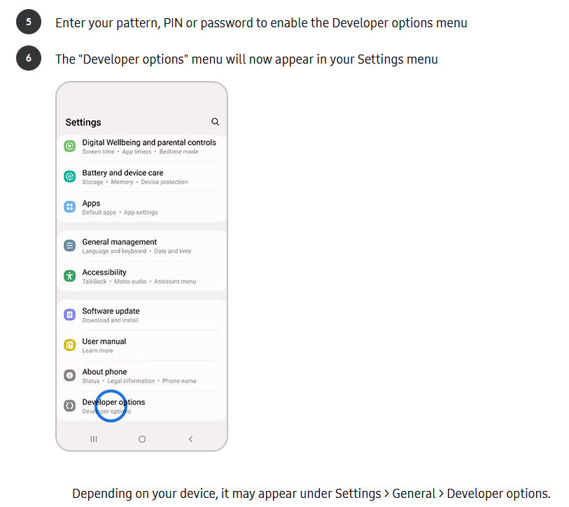
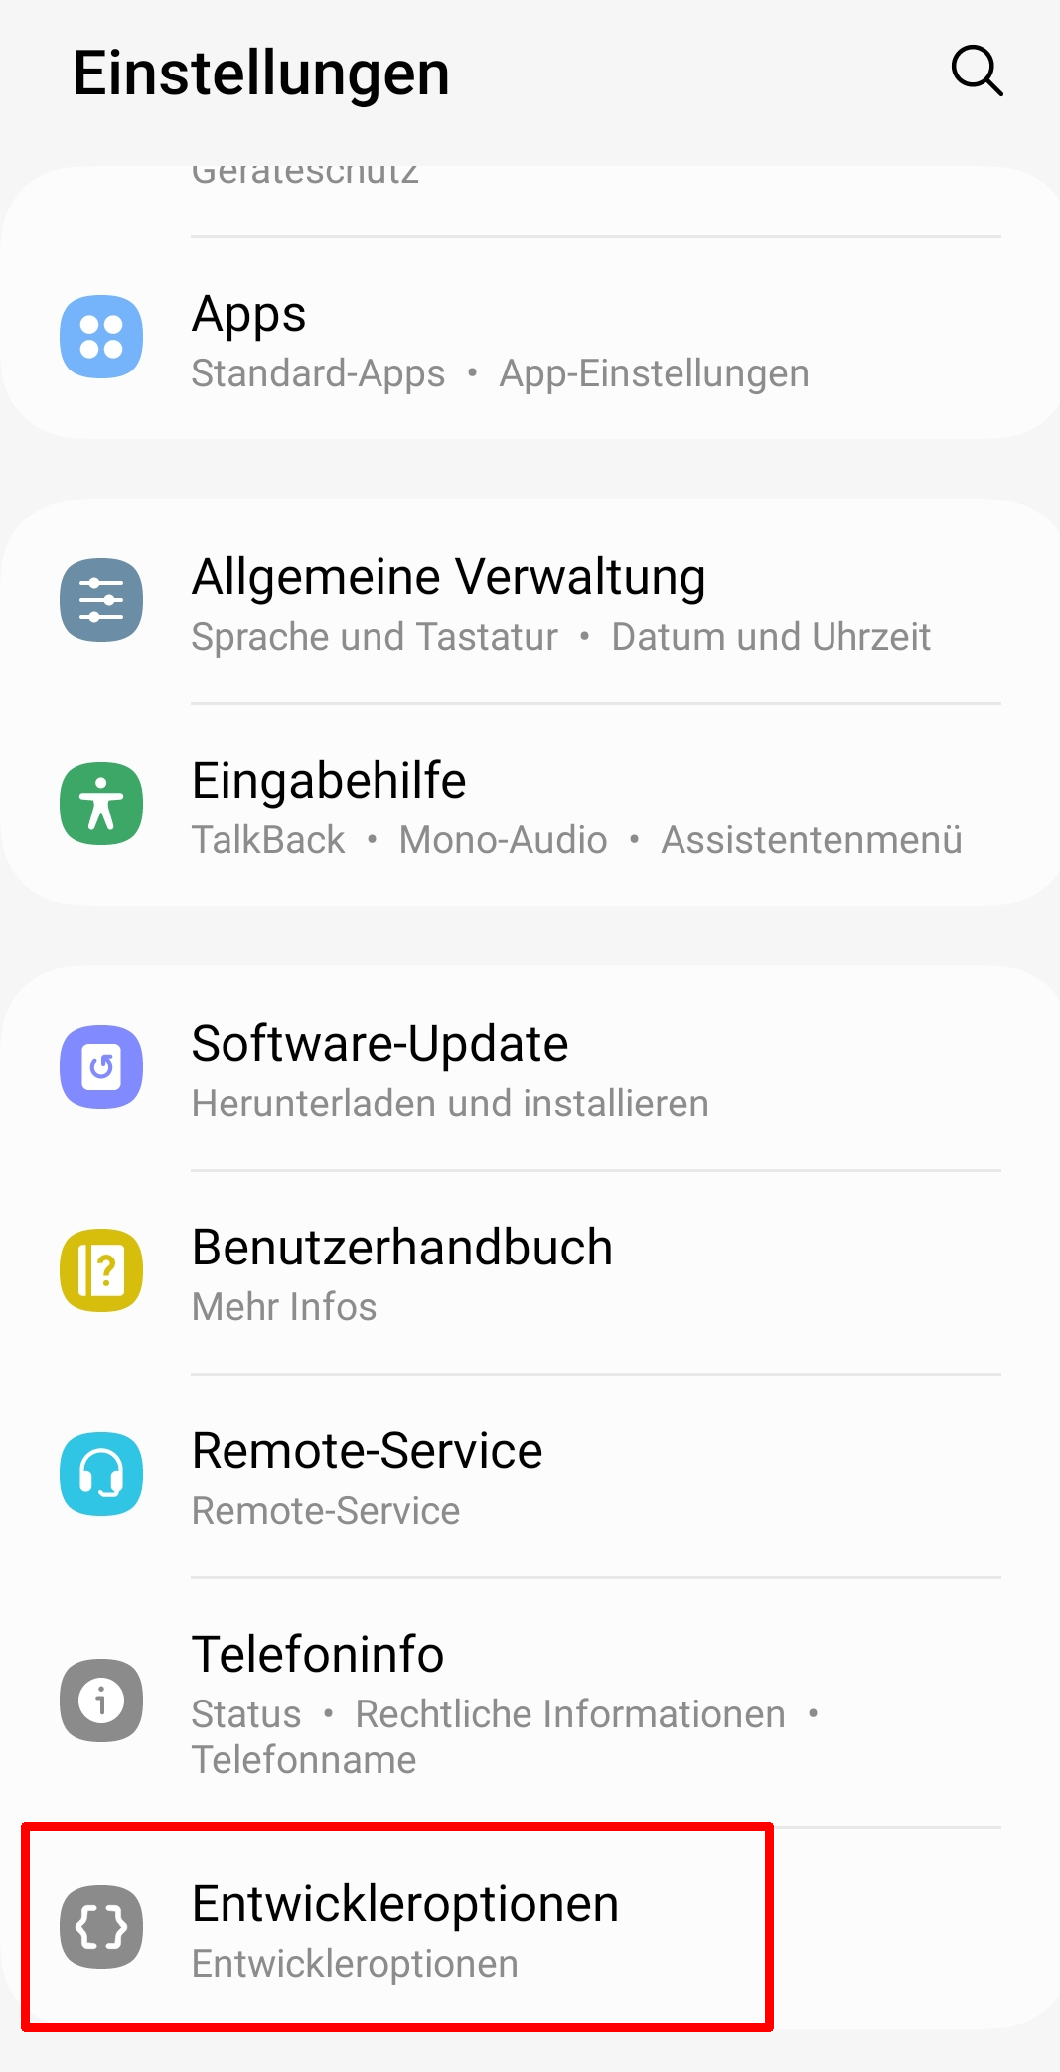

Slide 7
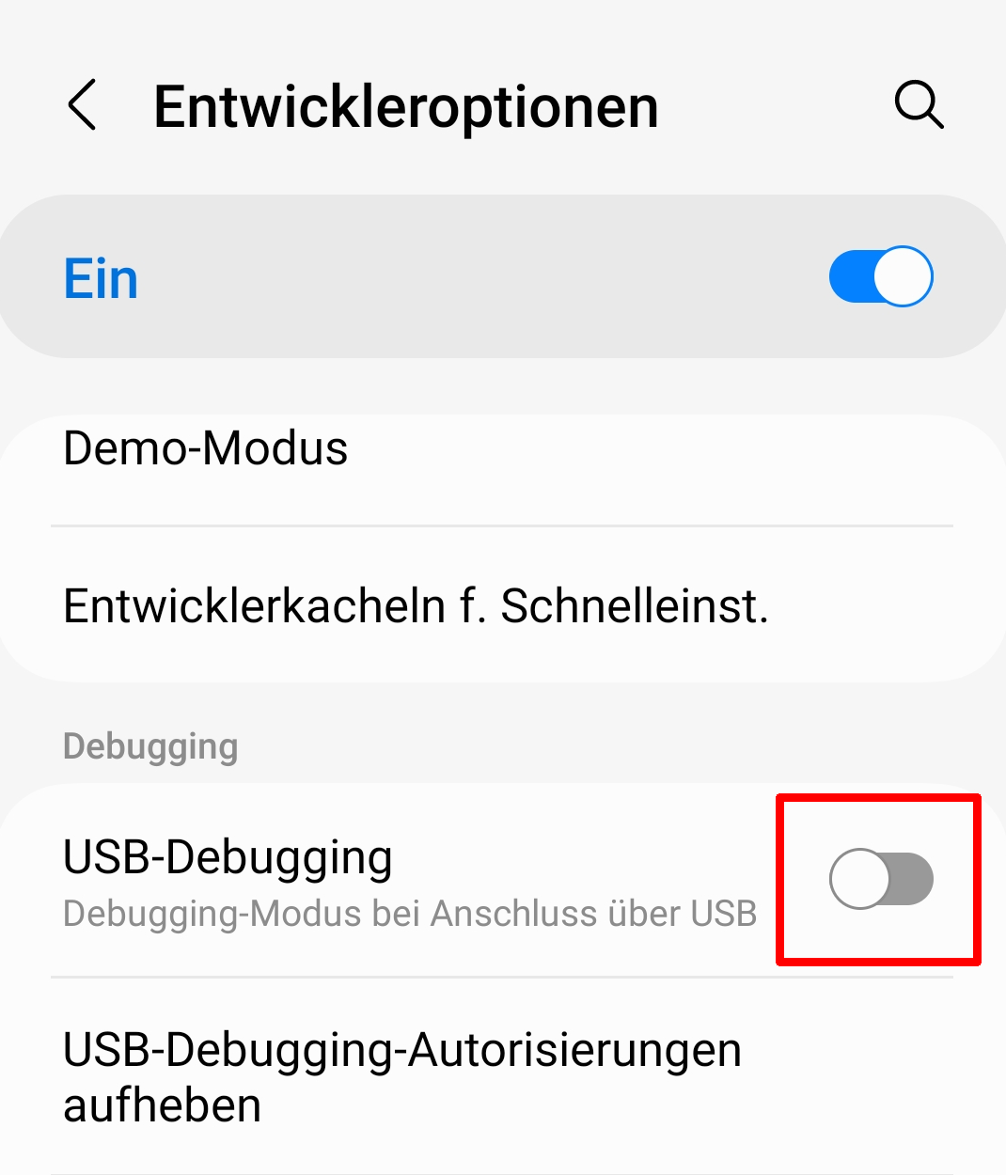
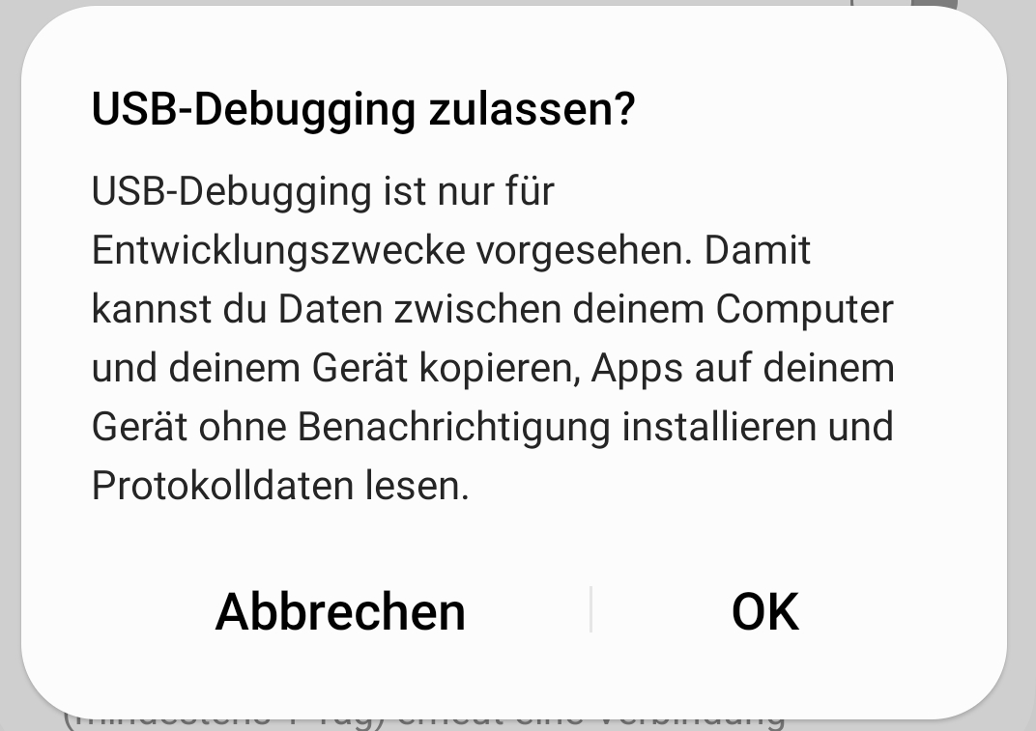
Switch USB Debugging ON
Open Developer Options and switch on USB-Debugging:
You will be asked:

Slide 8
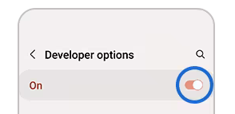
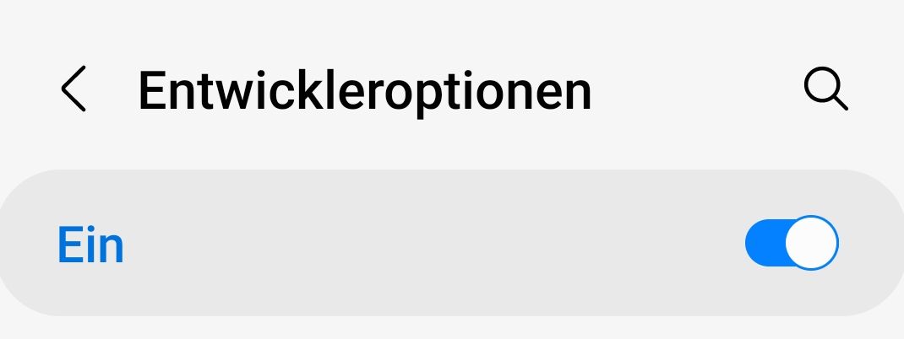
Take care
It is your responsibility to turn on Developer Options and USB Debugging.
In case any strange effects happen on your phone afterwards, neither your school nor your teacher take any warranty !
You can turn them easily off by tapping:

Slide 9
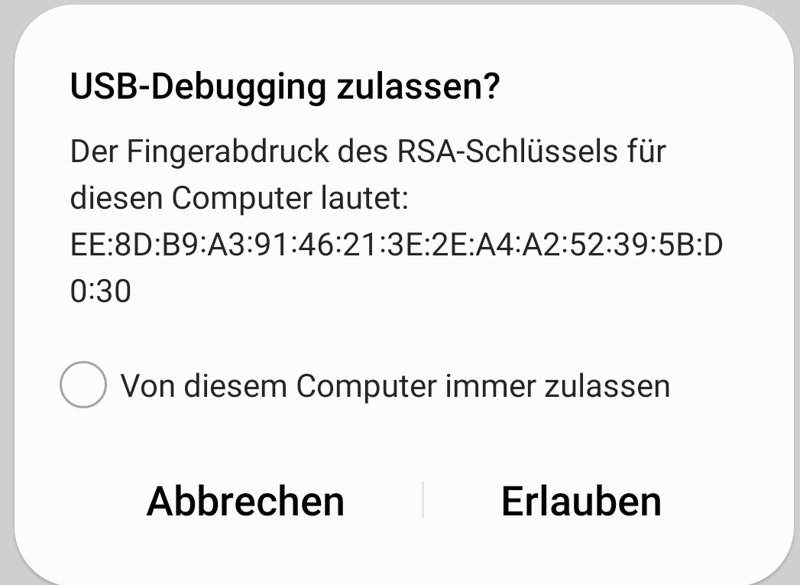
Test a flutter app on your phone (part 1)
After connecting your phone via USB to a Windows PC, you will be asked on your phone:

Slide 10
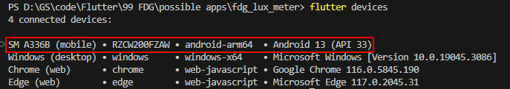
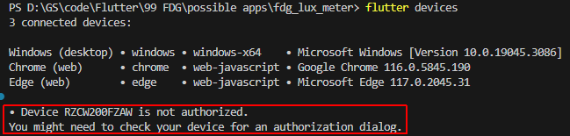
Test a flutter app on your phone (part 2)
When you allowed USB-Debugging in this last dialog, you should see your phone in “flutter devices”:
Otherwise it will be displayed as ‘not authorized’:

Slide 11

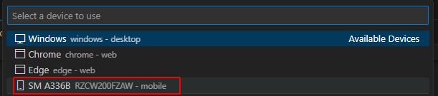
Test a flutter app on your phone (part 3)
When you see your phone in “flutter devices”, you can also select it as device in VS Code. Tap the right-most field in the status bar of VS Code:
And select your phone in the list of devices:
When you start debugging now by pressing F5 in VS Code, your app is transferred to your phone, installed there and executed.

